Slide 1
Data Structure & Algorithms
Dynamic Programming

Slide 2
Dynamic Programming
An algorithm design technique (like divide and conquer)
Divide and conquer
Partition the problem into independent subproblems
Solve the subproblems recursively
Combine the solutions to solve the original problem

Slide 3
Dynamic Programming
Applicable when subproblems are not independent
Subproblems share subsubproblems
E.g.: Combinations:
A divide and conquer approach would repeatedly solve the common subproblems
Dynamic programming solves every subproblem just once and stores the answer in a table
n
k
=
n-1
k
n-1
k-1
+
n
1
=1
n
n
=1

Slide 4
Example: Combinations
n
k
=
n-1
k
n-1
k-1
+

Slide 5
Dynamic Programming
Used for optimization problems
A set of choices must be made to get an optimal solution
Find a solution with the optimal value (minimum or maximum)
There may be many solutions that lead to an optimal value
Our goal: find an optimal solution

Slide 6
Dynamic Programming Algorithm
Characterize the structure of an optimal solution
Recursively define the value of an optimal solution
Compute the value of an optimal solution in a bottom-up fashion
Construct an optimal solution from computed information (not always necessary)

Slide 7
1) Characterize the optimal solution of the problem
Really understand the problem
Verify if an algorithm that verifies all solutions (brute force) is not enough
Try to generalize the problem (it takes practice to understand how to correctly generalize)
Try to divide the problem in subproblems of the same type Verify if the problem obeys the optimality principle
Verify if there are overlapping subproblems

Slide 8
2) Recursively define the optimal solution, by using optimal solutions of subproblems
Recursively define the optimal solution value, exactly and with rigour, from the solutions of subproblems of the same type
Imagine that the values of optimal solutions are already available when we need them
No need to code. You can just mathematically define the recursion

Slide 9
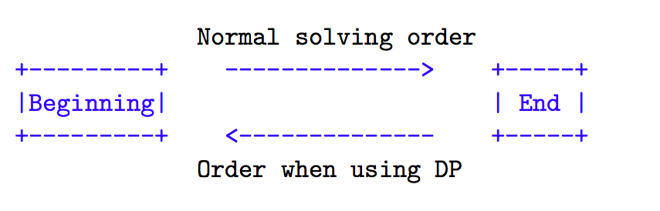
3) Compute the solutions of all subproblems: bottom-up
Find the order in which the subproblems are needed, from the smaller subproblem until we reach the global problem and implement, using a table
Usually this order is the inverse to the normal order of the recursive function that solves the problem

Slide 10
3) Compute the solutions of all subproblems: bottom-up example
Start computing result for the subproblem. Using the subproblem result solve another subproblem and finally solve the whole problem.
Let's find the nth member of a Fibonacci series.
Fibonacci(0) = 0
Fibonacci(1) = 1
Fibonacci(2) = 1 (Fibonacci(0) + Fibonacci(1))
Fibonacci(3) = 2 (Fibonacci(1) + Fibonacci(2))
We can solve the problem step by step.
1. Find Oth member
2. Find 1st member
3. Calculate the 2nd member using 0th and 1st member
4. Calculate the 3rd member using 1st and 2nd member
5. By doing this we can easily find the nth member.

Slide 11
3) Compute the solutions of all subproblems: bottom-up example
Algorithm:
1. set Fib[0] = 0
2. set Fib[1] = 1
3. From index 2 to n compute result using the below formula
Fib[index] = Fib[index - 1] + Fib[index - 2]
4. The final result will be stored in Fib[n].

Slide 12
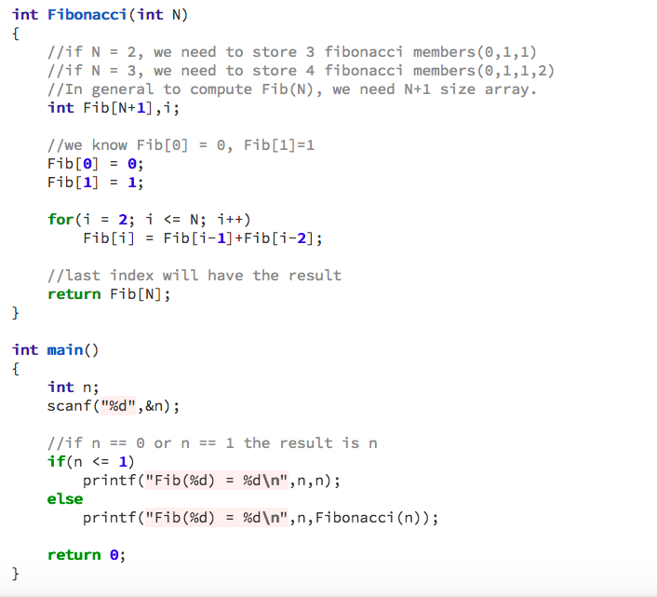
3) Compute the solutions of all subproblems: bottom-up example
Code:

Slide 13
3) Compute the solutions of all subproblems: top-down
There is a technique, known as ”memoization”, that allows us to solve the problem by the normal order.
Just use the recursive function directly obtained from the definition of the solution and keep a table with the results already computed.
When we need to access a value for the first time we need to compute it, and from then on we just need to see the already computed result.

Slide 14
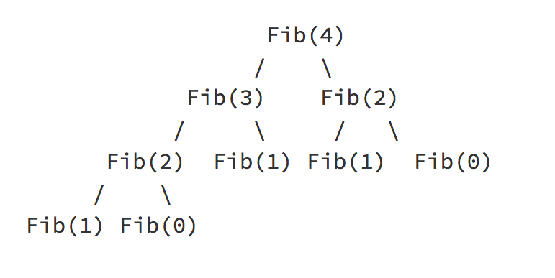
3) Compute the solutions of all subproblems: top-down example
Let's solve the same Fibonacci problem using the top-down approach.
Top-Down starts breaking the problem unlike bottom-up.
Like, If we want to compute Fibonacci(4), the top-down approach will do the following
Fibonacci(4) -> Go and compute Fibonacci(3) and Fibonacci(2) and return the results.
Fibonacci(3) -> Go and compute Fibonacci(2) and Fibonacci(1) and return the results.
Fibonacci(2) -> Go and compute Fibonacci(1) and Fibonacci(0) and return the results.
Finally, Fibonacci(1) will return 1 and Fibonacci(0) will return 0.

Slide 15
3) Compute the solutions of all subproblems: top-down example
Algorithm:
Fib(n)
If n == 0 || n == 1 return n;
Otherwise, compute subproblem results recursively.
return Fib(n-1) + Fib(n-2);

Slide 16
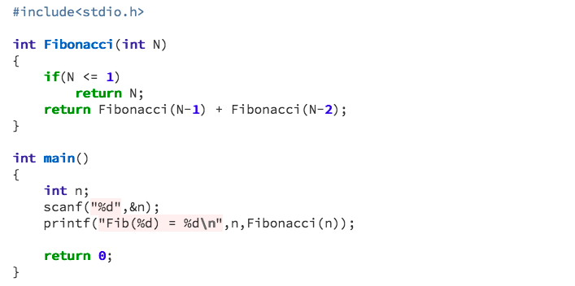
3) Compute the solutions of all subproblems: top-down example
Code:

Slide 17
4) Reconstruct the optimal solution, based on the computed values
It may (or may not) be needed, given what the problem asks for
Two alternatives:
Directly from the subproblems table
New table that stores the decisions in each step
If we do not need to know the solution in itself, we can eventually save some space

